Slide 1
Know Your Role A Hand Receipt Holder’s Guide to Property Accountability “Enterprise Standards” Version 2– Training for FY16
Vearlene Smith,
General Supply Specialist
CELA-MVM
US Army Corps of Engineers
BUILDING STRONG®

Slide 2
Training Slide Download Instructions
Click on the Round Windows Office Icon in the upper Left Corner.
Click on “Save as” to save on your computer.
Once slides are saved on your computer, Close SharePoint site, and then use the training slides.
By saving the Training Slides, you now have a ready reference to help manage your Hand Receipt Account (HRA)

Slide 3
An overview of the Primary Hand Receipt Holder’s (PHRHs) responsibilities and procedures for property accountability of ALL personal property procured using Government funds. REFERENCES
Purpose
AR 735-5, AR 710-2, AR 58-1, DA PAM 710-2-1, ER 700-1-1, & OPORD 2011-79

Slide 4
Agenda
Terms/Acronyms
Non-Expendable vs. Pilferable vs. Durable Property
Hand Receipt Holder Responsibilities
Sub-Hand Receipt Holder Responsibilities
Property Transfer
Property Loans
Property Loss, Damaged, or Destroyed
Inventory
Excess
DRMS/GSA Acquisitions

Slide 5
Terms / Acronyms
Primary Hand Receipt (PHR) - A signed document acknowledging acceptance of and responsibility for items of personal property.
Hand Receipt Account Number (HRA) - A number assigned to each area of responsibility.
Hand Receipt Holder (HRH) - A person who, either by virtue of position or by designation, is charged with direct responsibility for specifically identified government property. This will generally be a first-line supervisor.

Slide 6
Terms / Acronyms AR 735-5, para2-8
Supervisor Responsibility – Supervisors are obligated to ensure that ALL Government property issued to, or used by his subordinates is properly used and cared for. (AR 735-5, PARA 2-8)
Direct Responsibility- The obligation of a person to ensure that all Government property for which they have receipted, is properly used and cared for. (AR 735-5, PARA 2-8)
Personal Responsibility- The obligated of a person to exercise reasonable and prudent actions to ensure proper care and accountability of all Government property in their possession. (AR 735-5, PARA2-8)

Slide 7
Terms / Acronyms
Inventory - A physical count of all accountable property (use a scanner for recorded inventory).
Inventory Reconciliation - A match between physical counts and the accountable records.
Sub-hand Receipt – A hand receipt for property from a primary hand receipt holder or a sub-hand receipt holder to a person subsequently given the property for care, use, safekeeping or further issue. (DA PAM 710-2-1)

Slide 8
Nonexpendable Property AR 735-5, para 7-2, para 7-3
Nonexpendable Property- Is personal property that is not consumed in use and retains its original identity during the period of use.
Nonexpendable property requires formal accountability throughout the life of the item. Items will be accounted for at the using unit level using property book procedures.
Nonexpendable property is coded with an Accounting Requirements Code (ARC) of “N” in the Army Master Data File (AMDF) contained on FEDLOG. See AR 735-5, paragraph 7-2 and 7-3 for a description of various property items coded nonexpendable and the accounting requirements for nonexpendable property.

Slide 9
Pilferable Property OPORD 2011-79, Appendix A
Material having ready resale value or civilian application and are subject to theft. These items require formal accountability in APPMS.
These items will be identified by the DOL, ULA, Division, and/or District Commander.
Examples: Cameras, binoculars, chainsaws.

Slide 10
Durable Property AR 735-5, para 7-4, para 7-5, ER 700-1-1
Durable property is personal property that is not consumed in use and that does not require property book accountability but, because of its unique characteristics, requires control when issued to the user.
Durable property items are coded with an ARC of “D”.
Durable registers will be maintained by the PHRH.
Durable Property Managerial Reviews will be conducted for the Commander by the Logistics Office.

Slide 11
HRH’s Responsibilities AR 710-2, Appendix B, Table 2 ER 700-1-1
Maintain 100% accountability for property.
2 year Inventory – nonexpendable/Pilferable property
Assign property responsibilities thru sub-hand receipt procedures
Account for all items received outside normal CEFMS/APPMS channel IAW ER 700-1-1

Slide 12
HRH’s Responsibilities AR 735-5, para 13-2, Table 12-1, Table 12-2, ER 700-1-1
Identify Loss, Damage or Destroyed (LDD) government property.
Initiate Statement of Charges when liability for LDD property is admitted. (DD Form 362)
Initiate a FLIPL within 15 days of loss.
(DD Form 200 and DA Form 7531)
Letter of Lateness
If FLIPL is not initiated within 15 days of LDD discovery submit a letter of lateness as an exhibit to FLIPL

Slide 13
HRH’s Responsibilities AR 735-5, para 5-2
Notify the DPBO/Supply Tech of anticipated departure and designate an incoming HRH.
- A 100% joint inventory must be conducted.
Ensure that 100% of accountable property is inventoried every 2 years. Exception is: Major end items over $25,000 inventory annually. Sensitive items are inventoried monthly COMSEC/CCI are inventoried quarterly.
Sub-hand receipt all property to the user level.

Slide 14
HRH’s Responsibilities AR 735-5, para 5-4
AR 710-2, 1-21
Upon personnel changes (transfer, gain, retirement, etc.)
PHRHs must coordinate with DPBO/Supply Tech as part of their out-processing procedures.
NOTE: Outgoing HRH can be held liable until official change of HRH is complete.
Joint Inventory (incoming and outgoing HRH).

Slide 15
HRH’s Responsibilities AR 735-5, para 7-5,
OPORD 2011-79, 3(2)a-f, ER 700-1-1
Manage Durable Property in DMM
Establish 100% property accountability of all durable property using the DMM module in APPMS
Confirm completion of Managerial Review in writing.
Update Active Durable list
-Submit supporting documents to DPBO/Supply Tech.
DMM generated sub-hand receipts are recommended to be used.

Slide 16
Sub-HRH Responsibilities AR 710-2, para 2-10
Inventory and account for all property sub-hand receipted.
Inspect property upon receipt and verify all information for accuracy prior to signing sub-hand receipt.
Report any Loss, Damage or Destroyed property to the HRH as it occurs.

Slide 17
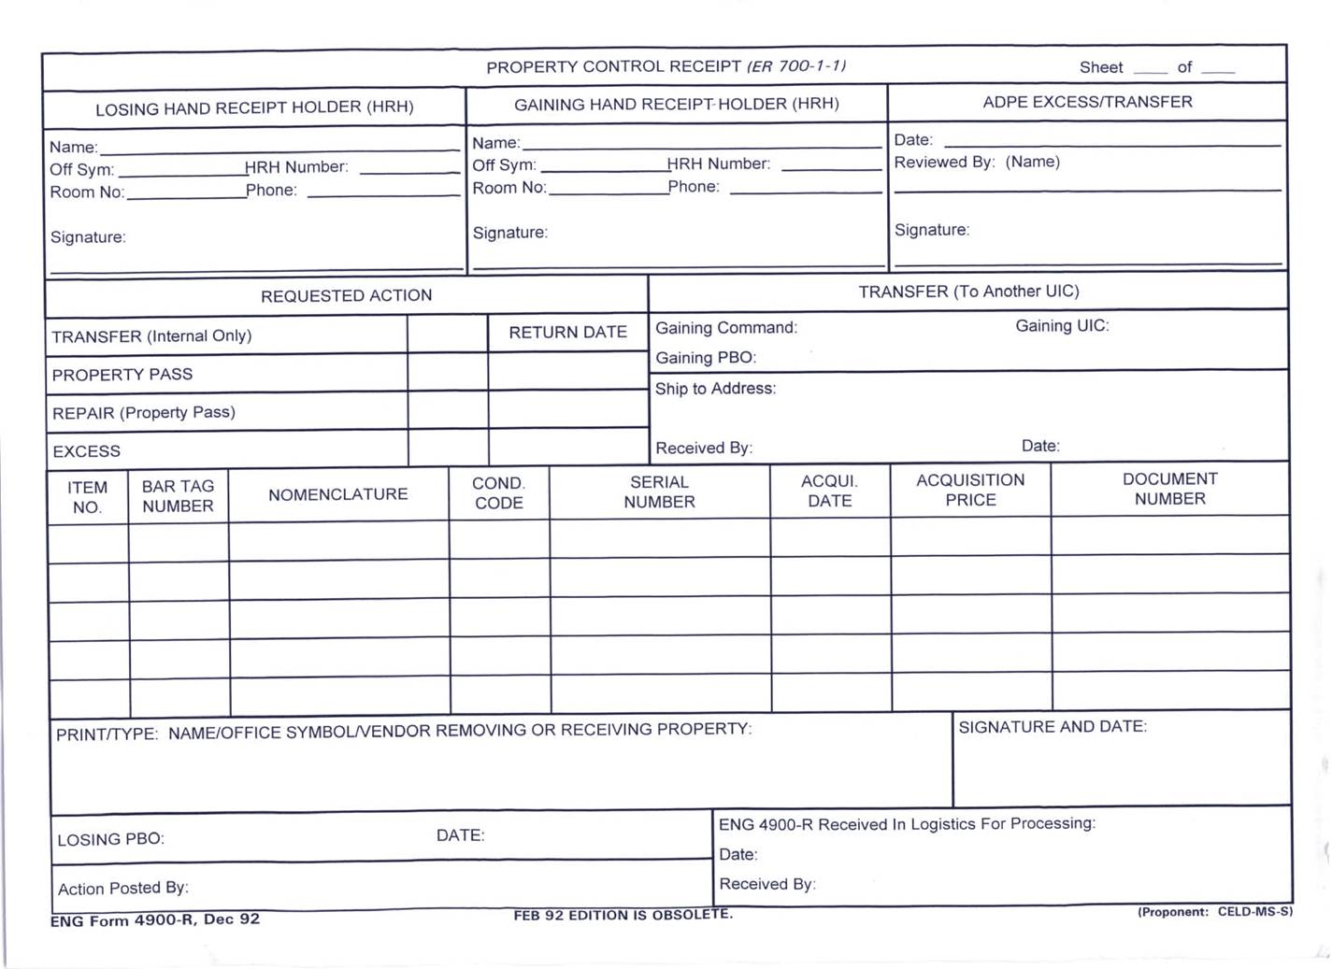
Transfer of Property
Form ENG 4900-R must be used to transfer property from one account to another.

Slide 18
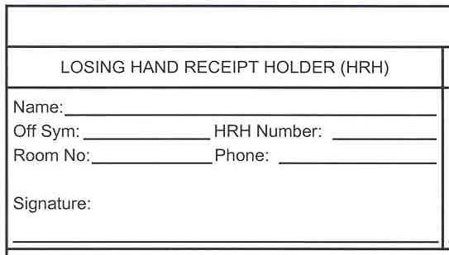
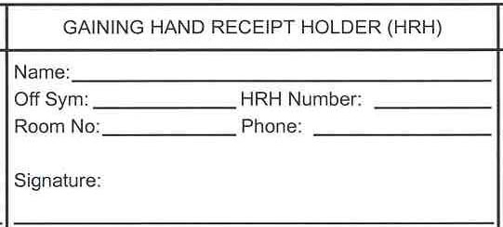
(1) The HRH transferring the property will sign as the LOSING HAND RECEIPT HOLDER.
(2) The HRH receiving the property will sign as the GAINING HAND RECEIPT HOLDER.

Slide 19
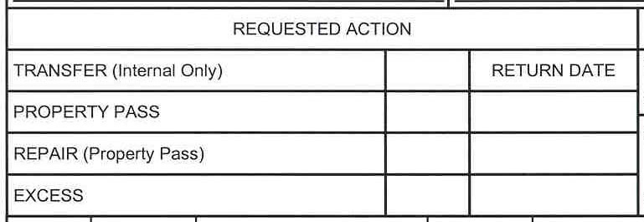
(3) Put a checkmark in the box indicating REQUESTED ACTION.
x

Slide 20
(4) List the BARTAG NUMBER, NOMENCLATURE and SERIAL NUMBER of the item(s) being requested for transfer.
(5) If someone other than the HRH (designated on DA Form 1687) is conducting property transaction, they will print their name in the space provided. SIGN and DATE where indicated.

Slide 21
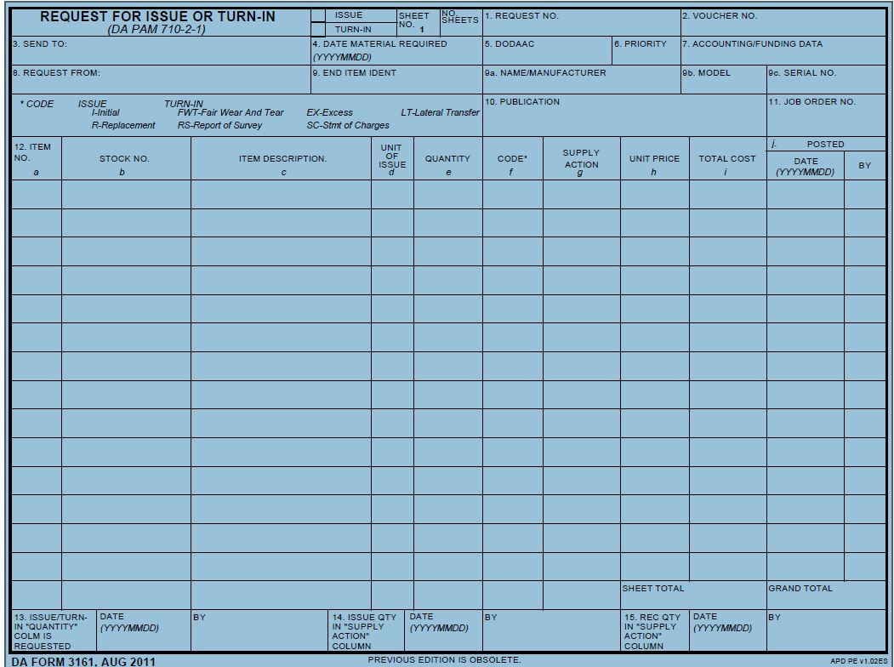
DA Form 3161

Slide 22
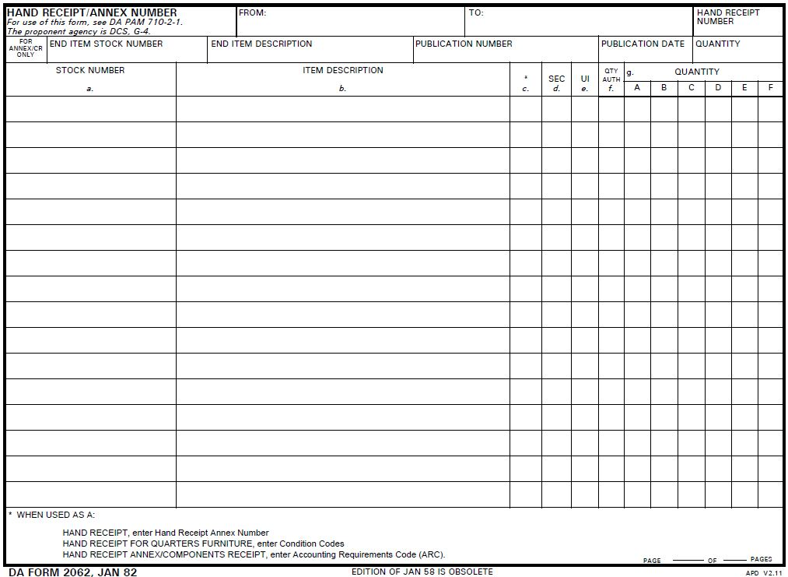
DA Form 2062

Slide 23
Property Loans ER 700-1-1
Property can be loaned to an individual outside the PHRH’s area of supervisory responsibility, only with the MCS Commander’s approval. Property on loan from a HRH will remain on his HRA listing until the property is properly returned.
Loaned property between subordinated elements within the same District will be accomplished through normal procedures by the DPBO.
Temporary Loans (HRH to HRH) are limited to 30 days.
Any property on loan after 30 days will either be withdrawn or transferred to the HRH using the property.

Slide 24
Property Loans
Procedure if loan is outside USACE , but within DOD: HRH MUST have approval from Commander before executing any loans outside of USACE. Not to exceed 180 days IAW ER 700-1-1
Procedure if loan is outside DOD: All property loans outside DOD must be approved by USACE DOL. Not to exceed 180 days IAW ER 700-1-1
Use DA Form 3161 to execute Property Loans

Slide 25
Property Loss, Damaged, or Destroyed AR 735-5, Chapter 13
ER 700-1-1
A Financial Liabilities Investigation of Property Loss (FLIPL) (DD Form 200 and DA 7531) is initiated by the PHRH when property in his/her account has been Lost, Damaged, or Destroyed through causes other than fair wear and tear.
The FLIPL must be initiated within 15 days of incident.
The original FLIPL with supporting documents must be provided to the DPBO/ Supply Tech for processing.

Slide 26
Property Loss, Damaged, or Destroyed AR 735-5, para 12-3
A DD Form 362 will be used in lieu of DD Form 200 if liability is admitted for loss/damage property.
DD Form 200 must be used when the amount of loss or damage exceeds the 1 month base pay or 1/12th the annual salary of the liable party regardless of admission of liability.

Slide 27
Property Loss, Damaged, or Destroyed AR 58-1 AR 735-5, para 13-14 d, e
ER 700-1-1
A FLIPL/Damage Statement must be initiated for every GSA vehicle involved in an accident that liability is not admitted IAW AR 735-5, Chapter 13 and AR 58-1, para. 2-10.
FLIPL’s involving Loss or Damage vehicles will be processed IAW AR 735-5, Chap 13.
For vehicle accidents, a SF-91 Motor Vehicle Accident Report, photographs of damage, 3 estimates for repair, and police report (if applicable) will be submitted with the FLIPL.
All personnel must acquire approval from the DLM or DPBO prior to disposal or repair of damaged property.

Slide 28
Property Loss, Damaged, or Destroyed AR 735-5, para 13-10
DD Form 200 is used to initiate an investigation of property loss.
Blocks 1 & 3 through 10 are completed either by the HRH or person w/ most knowledge of the incident.
Block 11 should be filled out by HRH.
Block 12 is completed by the Supervisor/PHRH.
Block 17 is completed by the DPBO.
All other Blocks through 20 are completed by the Appointing/Approving Authority.

Slide 29
Inventory AR 710-2, ER 700-1-1
When 100% accounting of all HRH items is completed, the Supply Tech will provide a final HR listing for signature, which signifies that property in is/her account has been properly accounted for.
Barcode Scanners must be used to perform the inventory.
The data collected from the barcode scanners is uploaded to APPMS, the program will separate the nonexpendable property in APPMS from durable property in DMM.

Slide 30
Inventory AR 710-2, ER 700-1-1
APPMS/DMM generates a three part report with the data collected by the scanner:
Reconciled Items – Accountable property belonging to the HRA being inventoried that has been scanned.
Shortages – Accountable property on the HRA that was not been scanned. This property must be located and scanned or a FLIPL must be initiated.
Overages – Property that was scanned that is not on the HRA being inventoried. Overages must be corrected on a case by case basis.

Slide 31
Inventory AR 710-2, ER 700-1-1
For Non-Expendable Property:
When all shortages and overages are reconciled, the Supply Tech /Specialist will provide the HRH with two copies of the property inventory list.
The PHRH will sign both copies of the property inventory list and return one copy to the DPBO/ Supply Tech within three days. The second copy is retained by the PHRH.

Slide 32
Excess Property AR 710-2, OPORD 2011-79
Property that is no longer utilized but still in serviceable condition and property that is no longer serviceable must be reported as excess.
Serviceable excess should be reported to the DLM Supply Staff (Supply Specialist/Supply Technician) for disposition instructions.
The process of excess turn-in is initiated with an ENG 4900/DA 3161.
The physical transfer of excess property should be coordinated with the DPBO/Supply Specialist/Supply Technician.

Slide 33
Forms
DA Form 3161 - Request for Issue or Turn-In
DA Form 2062 - Hand Receipt and Annex
ENG Form 4900 - Property Pass and Loan
DA Form 7531 - Checklist and Tracking Document for Financial Liability
DD Form 362 - Statement of Charges Cash Collection Voucher
DD Form 200 - Financial Liability Investigation of Property Loss (FLIPL)
DA Form 1687 - Delegation of Authority (Signature Card).
DA 4949 Administration Adjustment Report (AAR)
DA 2064 Document Register for Supply Actions.
ARMY PUBS and FORMS WEBSITE

Slide 34
CONGRATULATIONS! You have completed the ULA Hand Receipt Holders Training! Click on the ESC Button to revert to Normal view, then click on the next slide to add your name to the Certificate.

Slide 35
USACE LOGISTICS ACTIVITY
Certificate of Training
Presented to
Click here and add Name
For Successful Completion of the
SMD Training for Hand Receipt Holders
8 October 2014
Antonio A. Zapata
Chief, Supply and Maintenance Division

